Slide 1
Usability is not random #gdc13
macton@insomniacgames.com
@mike_acton

Slide 2
Where do we apply usability lessons?

Slide 3
Where do we apply usability lessons?
Tools UI
Game
API design
….everywhere!

Slide 4
Today’s goal
Mental model for recognizing and breaking down usability issues

Slide 5
Today’s goal
Mental model for recognizing and breaking down usability issues
Not even going to scratch the tip of the iceberg

Slide 6
Today’s goal
Mental model for recognizing and breaking down usability issues
Not even going to scratch the tip of the iceberg
Not a numbers talk

Slide 7
TL;DL

Slide 8
TL;DL
The only way is to watch it live

Slide 9
TL;DL
The only way is to watch it live
Choice is bad

Slide 10
TL;DL
The only way is to watch it live
Choice is bad
Choice is good

Slide 11
TL;DL
The only way is to watch it live
Choice is bad
Choice is good
20 Questions is all you ever need

Slide 12
TL;DL
The only way is to watch it live
Choice is bad
Choice is good
20 Questions is all you ever need
Learning curve is bad

Slide 13
TL;DL
The only way is to watch it live
Choice is bad
Choice is good
20 Questions is all you ever need
Learning curve is bad
Learning curve is good

Slide 14
TL;DL
The only way is to watch it live
Choice is bad
Choice is good
20 Questions is all you ever need
Learning curve is bad
Learning curve is good
One minute is worth 12 iterations

Slide 15
TL;DL
The only way is to watch it live
Choice is bad
Choice is good
20 Questions is all you ever need
Learning curve is bad
Learning curve is good
One minute is worth 12 iterations
When in doubt, be like Maya

Slide 16
Working definition: Usability
Total time required to solve the specified problem at the desired level of quality.

Slide 17
Let’s get this out of the way…

Slide 18
Let’s get this out of the way…
What tools do you use to measure?

Slide 19
Let’s get this out of the way…
What tools do you use to measure?
The only way is to watch it live

Slide 20
Let’s get this out of the way…
What tools do you use to measure?
The only way is to watch it live
To make things more usable, asking good questions is way more valuable than better tools.

Slide 21
What is usability a function of?
Context
Information density
Message creation
Message translation
Message response
Let’s understand each of these elements by example…

Slide 22
Example 1: Search

Slide 23
Example 1: Search
Context
Information density
Message creation
Message translation
Message response
Context is all agreed upon information.

Slide 24
Example 1: Search
Context
Information density
Message creation
Message translation
Message response
Context is all agreed upon information.
What problem are we trying to solve?

Slide 25
Example 1: Search
Context
Information density
Message creation
Message translation
Message response
Do we agree on what we’re trying to accomplish?

Slide 26
Example 1: Search
Context
Information density
Message creation
Message translation
Message response
Do we agree on what we’re trying to accomplish?
Magic words?
Magic store?
Music video?
Etymology?

Slide 27
Example 1: Search
Context
Information density
Message creation
Message translation
Message response
What’s the impact of such a broad context?

Slide 28
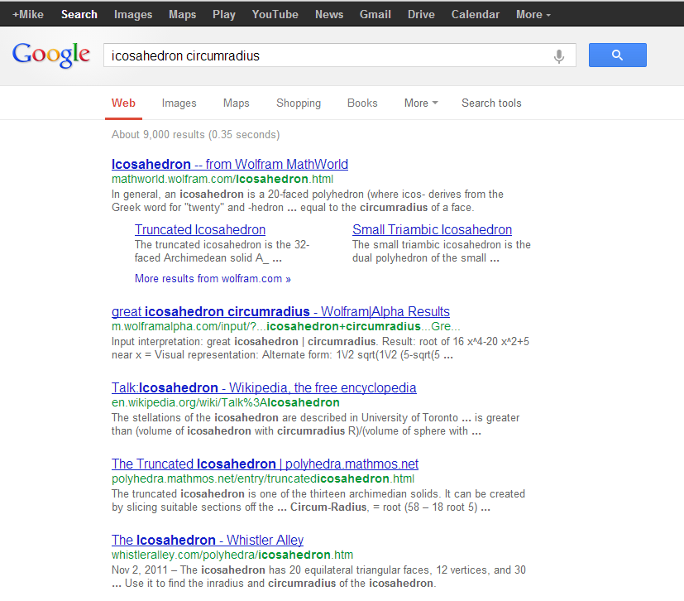
Must visually parse the results…

Slide 29
Must guess at possible answer and click link…

Slide 30
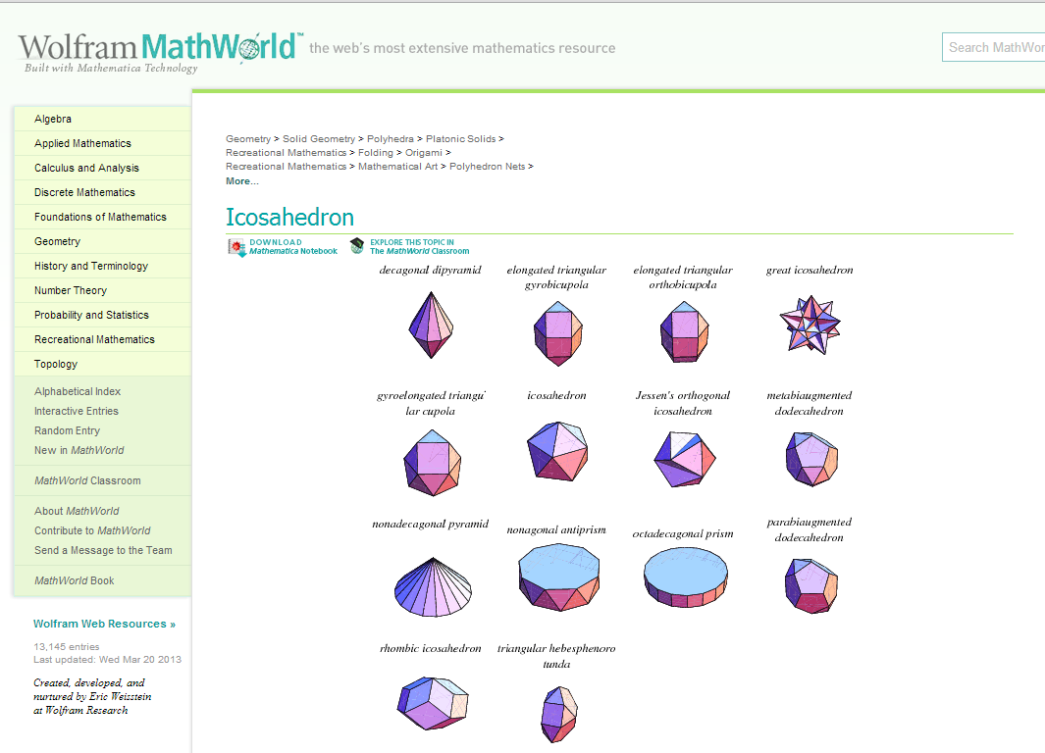
Must visually scan page for answer…

Slide 31
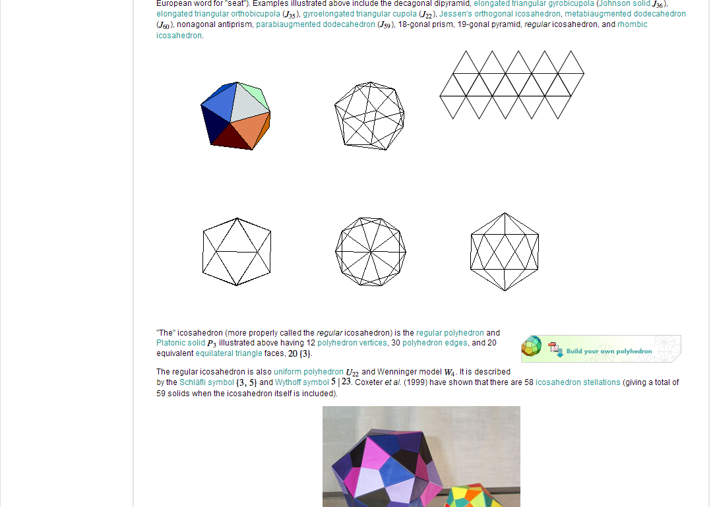
Scroll…

Slide 32
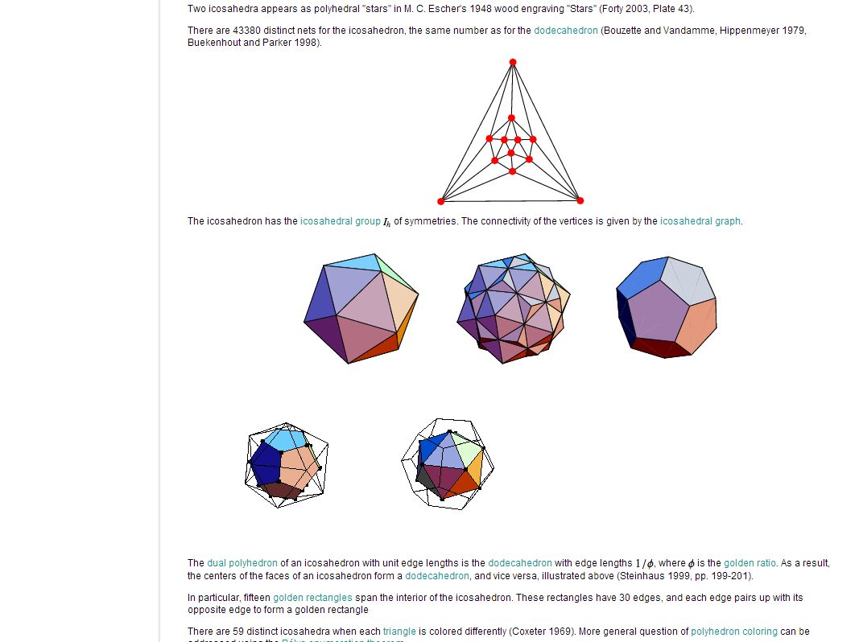
Scroll more…

Slide 33
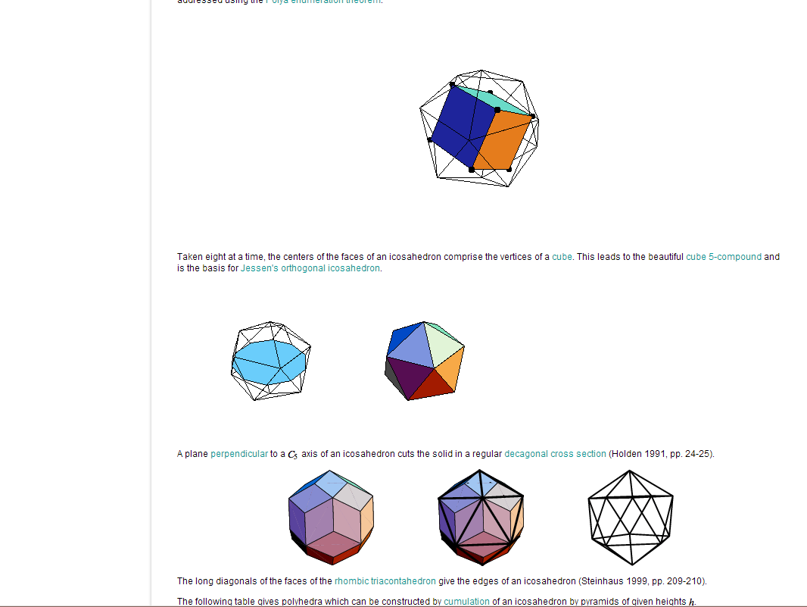
Keep scrolling…

Slide 34
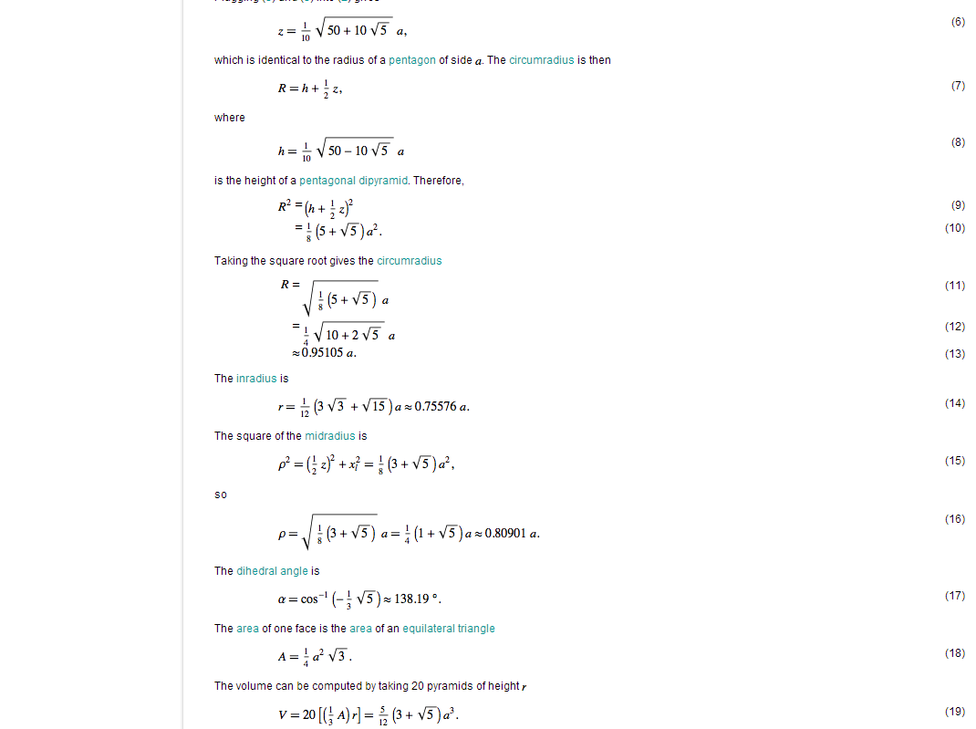
Eventually… if we’re paying attention, get answer.

Slide 35
If not… start over with another link

Slide 36
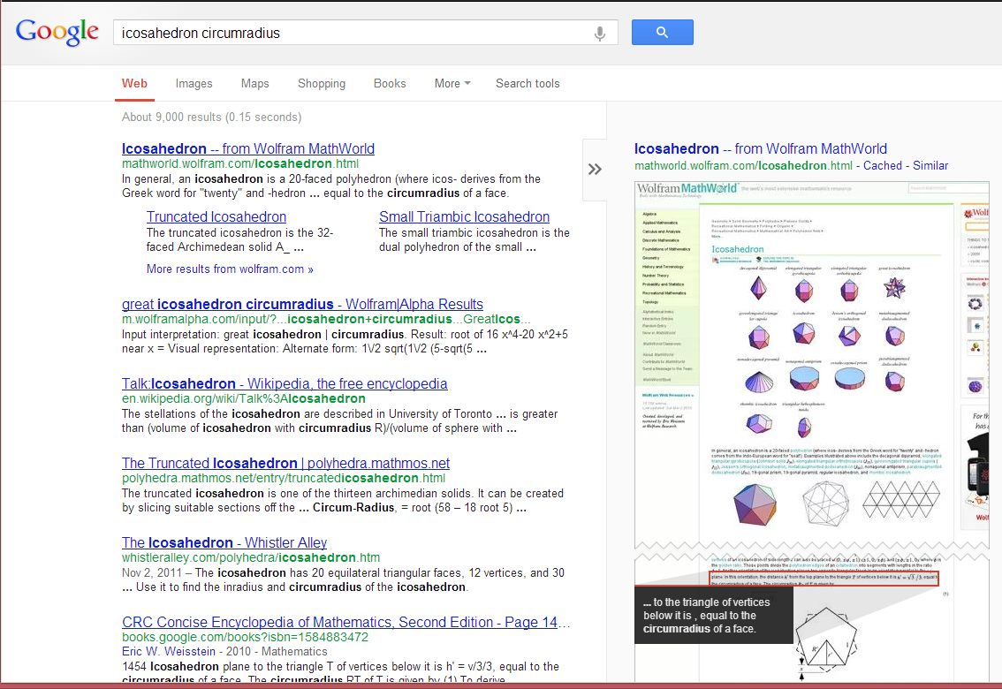
Improving, but…

Slide 37
Example 1: Search
Context
Information density
Message creation
Message translation
Message response
What if we had more context?
i.e. more agreed upon information

Slide 38

e.g. “computational knowledge”

Slide 39
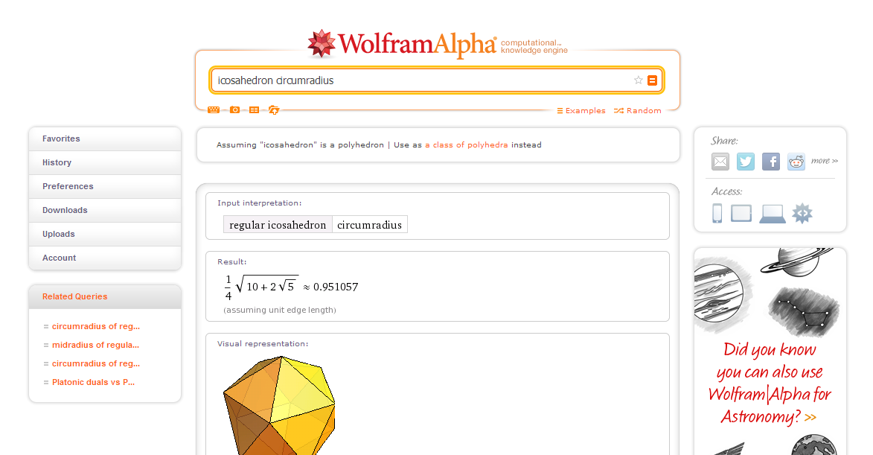

Slide 40
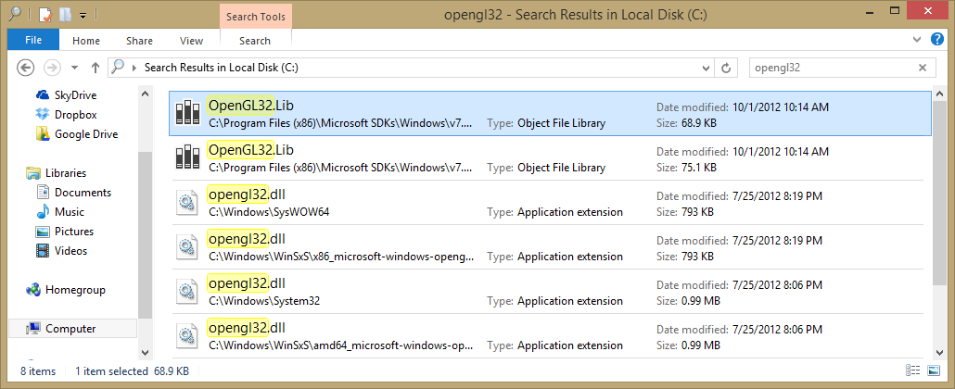
…or files in a file system

Slide 41
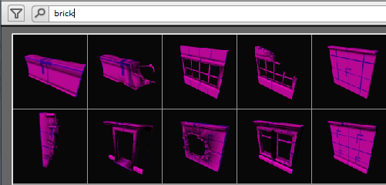
…or models in an asset tree

Slide 42
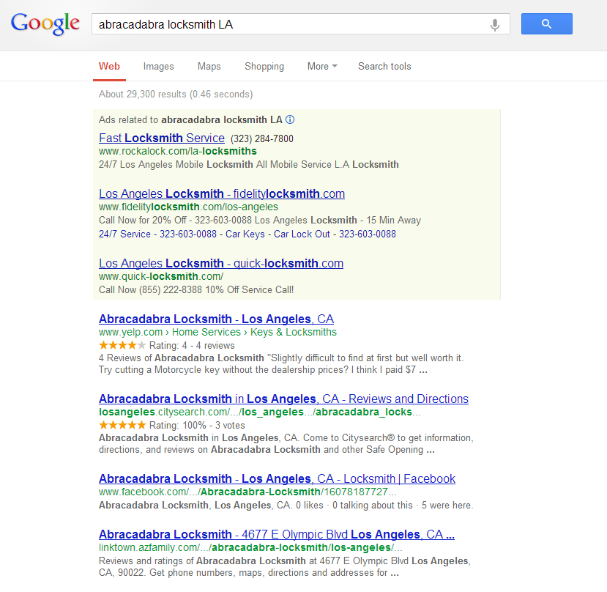
…or google-fu

Slide 43
...agree on more context in advance

Slide 44
Example 1: Search
Context
Information density
Message creation
Message translation
Message response
What if we had less context?

Slide 45
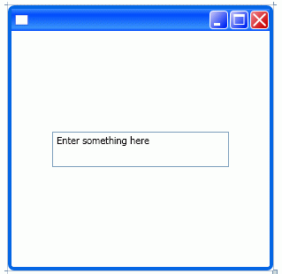
e.g. generic text entry box

Slide 46
e.g. generic text entry box
Less context = fewer constraints?

Slide 47
e.g. generic text entry box
Less context = fewer constraints?
How many characters?

Slide 48
e.g. generic text entry box
Less context = fewer constraints?
How many characters?
What kind of characters?

Slide 49
e.g. generic text entry box
Less context = fewer constraints?
How many characters?
What kind of characters?
What do we know about the problem?

Slide 50
Example 1: Search
Context
Information density
Message creation
Message translation
Message response
The upper limit of usability is determined by the amount of agreed upon information we start with.

Slide 51
This is more usable…

Slide 52
…than this…

Slide 53
…but only if we agree beforehand that we’re searching for “computational knowledge”

Slide 54
Example 1: Search
Context
Information density
Message creation
Message translation
Message response
The upper limit of usability is determined by the amount of agreed upon information we start with.

Slide 55
Example 1: Search
Context
Information density
Message creation
Message translation
Message response
The upper limit of usability is determined by the amount of agreed upon information we start with.
i.e. More constraints = More (potentially) usable

Slide 56
Example 1: Search
Context
Information density
Message creation
Message translation
Message response
Choice is Bad
The upper limit of usability is determined by the amount of agreed upon information we start with.
i.e. More constraints = More (potentially) usable

Slide 57
Example 1: Search
Context
Information density
Message creation
Message translation
Message response
Choice is Bad
To make things more usable, solve more specific, not more generic, problem.
The upper limit of usability is determined by the amount of agreed upon information we start with.
i.e. More constraints = More (potentially) usable

Slide 58
Choice is Bad
How do you measure it?
How do you know when to stop?

Slide 59
Example 1: Search
Context
Information density
Message creation
Message translation
Message response
Hunt
(What we’ve seen so far…)

Slide 60
Example 1: Search
Context
Information density
Message creation
Message translation
Message response
Hunt
(Know what the end result is…)

Slide 61
Example 1: Search
Context
Information density
Message creation
Message translation
Message response
Hunt
Play

Slide 62
Example 1: Search
Context
Information density
Message creation
Message translation
Message response
Hunt
Play
“I don’t know what I’m looking for,
but I’ll know it when I see it.”

Slide 63
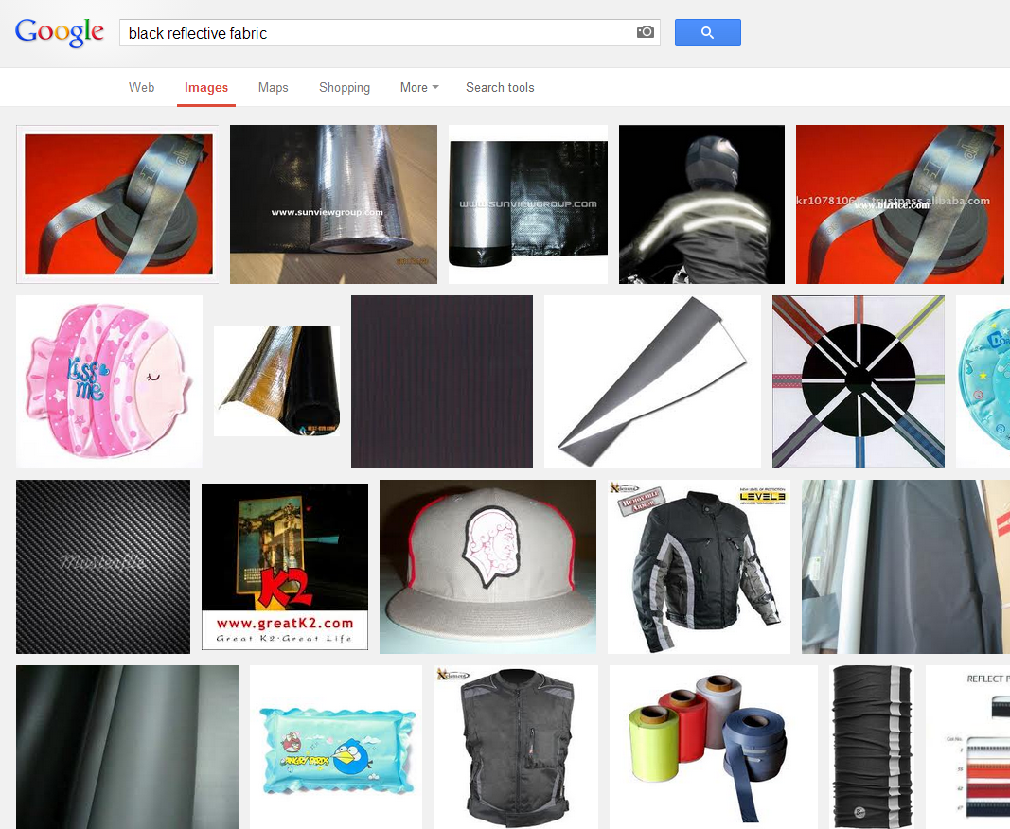
(Play)
i.e. Iteration, Inspiration, Creative, …

Slide 64
In other words, (hunt vs. play)….
A
B
xform
The only purpose of any program is to transform some data from one form (A) into another form (B)

Slide 65
In other words, (hunt vs. play)….
A
B
hunt
When you know what (B) is

Slide 66
In other words, (hunt vs. play)….
A
?
play
When you don’t

Slide 67
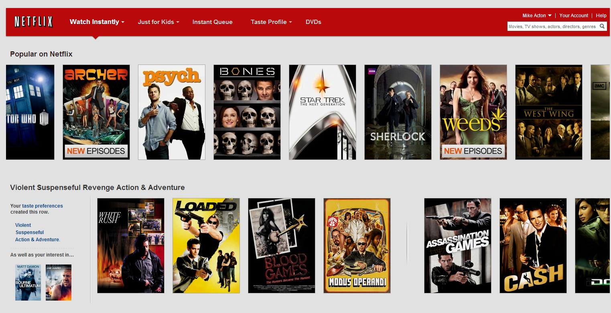

Slide 68
(Play)
Many choices, quickly…

Slide 69
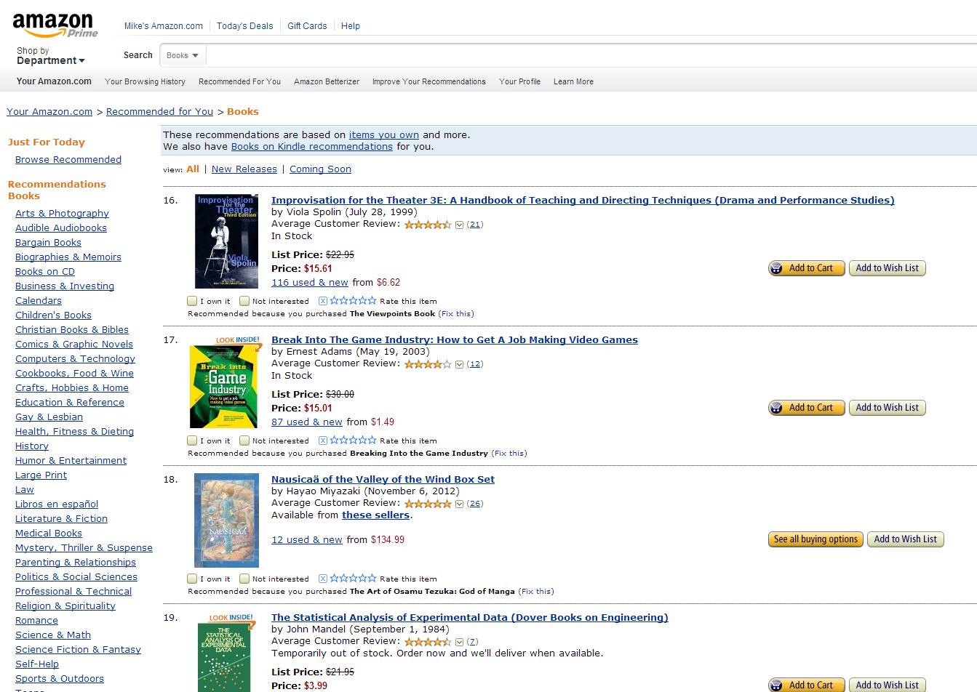

Slide 70
(Play)
Recommend more choices, quickly…

Slide 71
In other words, (hunt vs. play)….
A
?
play
When you don’t know what you want…

Slide 72
In other words, (hunt vs. play)….
Choice is Good
A
?
play
When you don’t know what you want…

Slide 73
In other words, (hunt vs. play)….
Choice is Good
A
?
play
To make things more usable, present lots of relevant, comparable options quickly.
When you don’t know what you want…

Slide 74
Choice is Good
How do you measure it?
How do you know what to show?

Slide 75
Example 1: Search
Context
Information density
Message creation
Message translation
Message response
Hunt
Very different problems. Very different solutions.
Play

Slide 76
Example 1: Search
Context
Information density
Message creation
Message translation
Message response

Slide 77
Example 1: Search
Context
Information density
Message creation
Message translation
Message response
Amount of the problem that can be solved with any particular message.

Slide 78
Example 1: Search
Context
Information density
Message creation
Message translation
Message response
Amount of the problem that can be solved with any particular message.
Message = data associated with each step of a process

Slide 79
Start search

Slide 80
Start search
Visually parse the results…

Slide 81
Start search
Visually parse the results…
Guess at possible answer and click link…

Slide 82
Start search
Visually parse the results…
Guess at possible answer and click link…
Scan page for answer…

Slide 83
Start search
Visually parse the results…
Guess at possible answer and click link…
Scan page for answer…
Scroll…

Slide 84
Start search
Visually parse the results…
Guess at possible answer and click link…
Scan page for answer…
Scroll…
Found result?

Slide 85
Start search
Visually parse the results…
Guess at possible answer and click link…
Scan page for answer…
Scroll…
Found result?
No

Slide 86
Start search
Search text
Visually parse the results…
Guess at possible answer and click link…
Scan page for answer…
Scroll…
Found result?
No

Slide 87
Start search
Search text
List of possibilities
Visually parse the results…
Guess at possible answer and click link…
Scan page for answer…
Scroll…
Found result?
No

Slide 88
Start search
Search text
List of possibilities
Visually parse the results…
Mouse scroll,
page click
Guess at possible answer and click link…
Scan page for answer…
Scroll…
Found result?
No

Slide 89
Start search
Search text
List of possibilities
Visually parse the results…
Mouse scroll,
page click
List more possibilities
Guess at possible answer and click link…
Scan page for answer…
Scroll…
Found result?
No

Slide 90
Start search
Search text
List of possibilities
Visually parse the results…
Mouse scroll,
page click
List more possibilities
Guess at possible answer and click link…
Link click
Scan page for answer…
Scroll…
Found result?
No

Slide 91
Start search
Search text
List of possibilities
Visually parse the results…
Mouse scroll,
page click
List more possibilities
Guess at possible answer and click link…
Link click
Page result
Scan page for answer…
Scroll…
Found result?
No

Slide 92
Start search
Search text
List of possibilities
Visually parse the results…
Mouse scroll,
page click
List more possibilities
Guess at possible answer and click link…
Link click
Page result
Scan page for answer…
Scroll…
Found result?
No

Slide 93
Start search
Search text
List of possibilities
Visually parse the results…
Mouse scroll,
page click
List more possibilities
Guess at possible answer and click link…
Link click
Page result
Scan page for answer…
Scroll…
Mouse scroll,
Page down
Found result?
No

Slide 94
Start search
Search text
List of possibilities
Visually parse the results…
Mouse scroll,
page click
List more possibilities
Guess at possible answer and click link…
Link click
Page result
Scan page for answer…
Scroll…
Mouse scroll,
Page down
More page result
Found result?
No

Slide 95
Start search
Search text
List of possibilities
Visually parse the results…
Mouse scroll,
page click
List more possibilities
Guess at possible answer and click link…
Link click
Page result
Scan page for answer…
Scroll…
Mouse scroll,
Page down
More page result
Found result?
No

Slide 96
Start search
Search text
List of possibilities
Visually parse the results…
Mouse scroll,
page click
List more possibilities
Guess at possible answer and click link…
Link click
Page result
Scan page for answer…
Scroll…
Mouse scroll,
Page down
More page result
Found result?
No
Back button

Slide 97
Start search
Search text
List of possibilities
Visually parse the results…
Mouse scroll,
page click
List more possibilities
Guess at possible answer and click link…
Link click
Page result
Scan page for answer…
Scroll…
Mouse scroll,
Page down
More page result
Found result?
No
Back button
List of possibilities

Slide 98
Example 1: Search
Context
Information density
Message creation
Message translation
Message response
The amount that each message reduces the search space

Slide 99
Example 1: Search
Context
Information density
Message creation
Message translation
Message response
The amount that each message reduces the search space
Every problem is like a game of 20 Questions.

Slide 100
Example 1: Search
Context
Information density
Message creation
Message translation
Message response
This message is made up of smaller messages…
a
b
r
a
c
a
d
a
b
r
a

Slide 101
a
b
r
a
c
a
d
a
b
r
a
What does the first message tell us?

Slide 102
a
b
r
a
c
a
d
a
b
r
a
What does the first message tell us?
‘a’ is U+0061, which is in the ‘Basic Latin’ Unicode block

Slide 103
a
b
r
a
c
a
d
a
b
r
a
What does the first message tell us?
‘a’ is U+0061, which is in the ‘Basic Latin’ Unicode block
Which means we’re likely searching in EFIGS

Slide 104
a
b
r
a
c
a
d
a
b
r
a
What does the first message tell us?
‘a’ is U+0061, which is in the ‘Basic Latin’ Unicode block
Which means we’re likely searching in EFIGS
Based on context: Most likely in English

Slide 105
a
b
r
a
c
a
d
a
b
r
a
What does the first message tell us?
‘a’ is U+0061, which is in the ‘Basic Latin’ Unicode block
Which means we’re likely searching in EFIGS
Based on context: Most likely in English
In dictionary of ~110,000 common English words, there are only ~6,500 words that begin with ‘a’.

Slide 106
a
b
r
a
c
a
d
a
b
r
a
What does the first message tell us?
‘a’ is U+0061, which is in the ‘Basic Latin’ Unicode block
Which means we’re likely searching in EFIGS
Based on context: Most likely in English
In dictionary of ~110,000 common English words, there are only ~6,500 words that begin with ‘a’.
Reduced likely results from near-infinite to ~6,500

Slide 107
a
b
r
a
c
a
d
a
b
r
a
…and together ‘a’ + ‘b’ reduces our search space to ~420 words in the same dictionary.

Slide 108
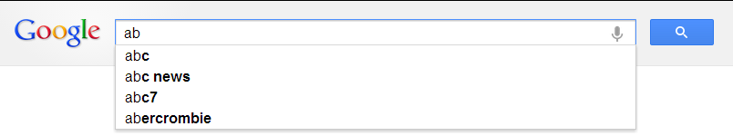
a
b
r
a
c
a
d
a
b
r
a
…and together ‘a’ + ‘b’ reduces our search space to ~420 words in the same dictionary.
We can start to make reasonable guesses…
(Obviously Google’s search space is much bigger
than a sample dictionary.)

Slide 109
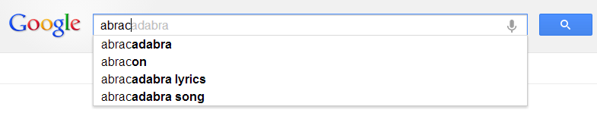
a
b
r
a
c
a
d
a
b
r
a
By the 5th message, the most likely answer is the correct one…

Slide 110
a
b
r
a
c
a
d
a
b
r
a
A lot
Almost none
If context is well-defined, information density should map like this…
(Like a game of 20 Questions)

Slide 111
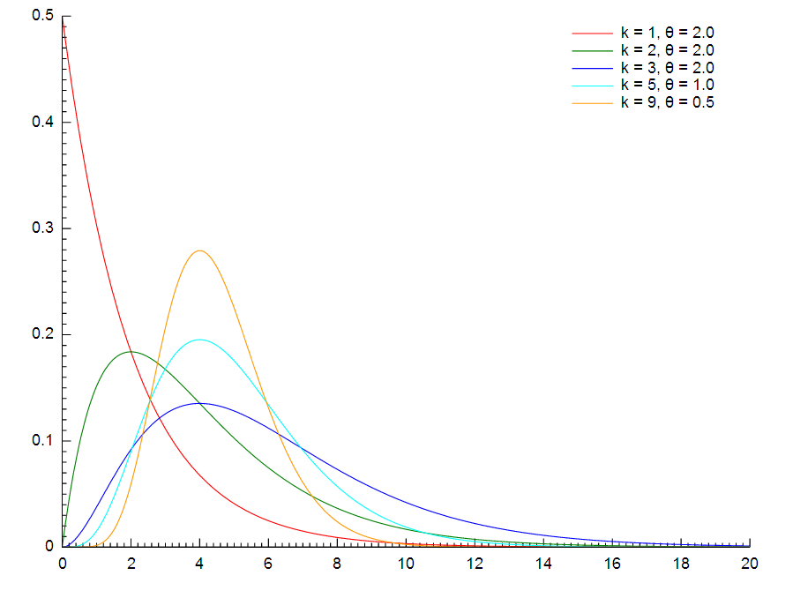
http://en.wikipedia.org/wiki/File:Gamma_distribution_pdf.svg
Not every well-formed case looks like this…

Slide 112
http://en.wikipedia.org/wiki/File:Gamma_distribution_pdf.svg
…but it should be in this family of distributions

Slide 113
If we look back at our search messages…

Slide 114
Start search
Search text
List of possibilities
Visually parse the results…
Mouse scroll,
page click
List more possibilities
Guess at possible answer and click link…
Link click
Page result
Scan page for answer…
Scroll…
Mouse scroll,
Page down
More page result
Found result?
No
Back button
List of possibilities

Slide 115
What would that information density look like?

Slide 116
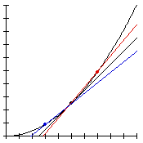
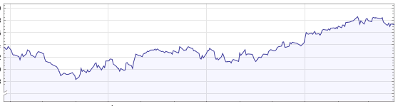
If your information density looks like this…
or

Slide 117
If your information density looks like this…
or
Your context probably isn’t well-defined.

Slide 118
If your information density looks like this…
20 Questions is all you ever need
or
Your context probably isn’t well-defined.
To make things more usable, map context so that most likely stuff comes first

Slide 119
Example 2: Screenshot Dialog
Context
Information density
Message creation
Message translation
Message response
Amount of time required to act correctly

Slide 120
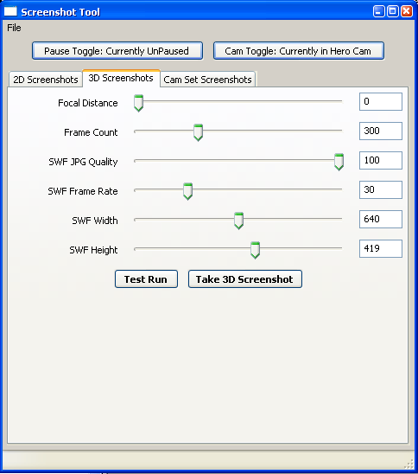
What’s wrong with this?
Need to do calculations in your head

Slide 121
What’s wrong with this?
Need to do calculations in your head

Slide 122
What’s wrong with this?
Need to do calculations in your head
Need to choose between a lot of unknown options

Slide 123
What’s wrong with this?
Need to do calculations in your head
Need to choose between a lot of unknown options
Options too granular

Slide 124
What’s wrong with this?
Need to do calculations in your head
Need to choose between a lot of unknown options
Options too granular
Lots of unused, not useful options

Slide 125
What’s wrong with this?
Need to do calculations in your head
Need to choose between a lot of unknown options
Options too granular
Lots of unused, not useful options
Even more unused, not useful options

Slide 126
What’s wrong with this?
Need to do calculations in your head
Need to choose between a lot of unknown options
Options too granular
Lots of unused, not useful options
Even more unused, not useful options
Unclear how to choose the right answer

Slide 127
Example 2: Screenshot Dialog
Context
Information density
Message creation
Message translation
Message response
Things to Measure

Slide 128
Example 2: Screenshot Dialog
Context
Information density
Message creation
Message translation
Message response
Things to Measure
Parsing time

Slide 129
Example 2: Screenshot Dialog
Context
Information density
Message creation
Message translation
Message response
Things to Measure
Parsing time
Thinking time

Slide 130
Example 2: Screenshot Dialog
Context
Information density
Message creation
Message translation
Message response
Things to Measure
Parsing time
Thinking time
Working on wrong problem

Slide 131
Example 2: Screenshot Dialog
Context
Information density
Message creation
Message translation
Message response
Things to Measure
Parsing time
Thinking time
Working on wrong problem
Error rate

Slide 132
Example 2: Screenshot Dialog
Context
Information density
Message creation
Message translation
Message response
Learning curve is bad
Things to Measure
Parsing time
Thinking time
Working on wrong problem
Error rate
To make things more usable, reduce the time needed to work out what the right thing to do is

Slide 133
Example 2: Screenshot Dialog
Context
Information density
Message creation
Message translation
Message response
However… message creation time improves over time.

Slide 134
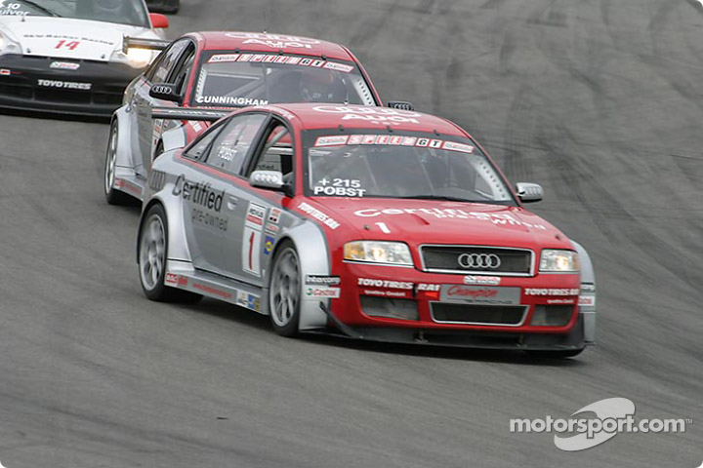
Initial difficulty isn’t always bad...
e.g. Driving

Slide 135
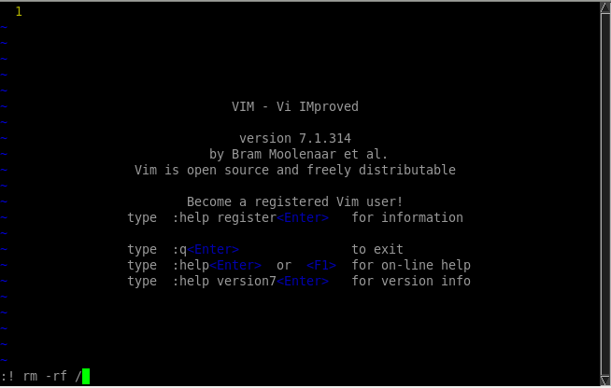
e.g. vi(m)

Slide 136
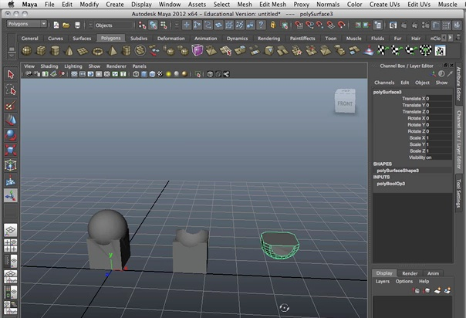
e.g. maya

Slide 137

e.g. making games

Slide 138
Example 2: Screenshot Dialog
Context
Information density
Message creation
Message translation
Message response
Learning curve is good
However… message creation time improves over time.

Slide 139
Example 2: Screenshot Dialog
Context
Information density
Message creation
Message translation
Message response
Learning curve is good
However… message creation time improves over time.
To make things more usable, allow for some features that are only useful with lots of practice.

Slide 140
Example 3: Build times
Context
Information density
Message creation
Message translation
Message response
Latency to transform message to useful result.

Slide 141
Example 3: Build times
Context
Information density
Message creation
Message translation
Message response
Latency to transform message to useful result.
When people say “iteration”…

Slide 142
Example 3: Build times
Context
Information density
Message creation
Message translation
Message response
Latency to transform message to useful result.
When people say “iteration”…
Easiest to measure

Slide 143
Example 3: Build times
Context
Information density
Message creation
Message translation
Message response
Latency to transform message to useful result.
When people say “iteration”…
Easiest to measure
e.g. Building levels

Slide 144
Example 3: Build times
Context
Information density
Message creation
Message translation
Message response
Latency to transform message to useful result.
When people say “iteration”…
Easiest to measure
e.g. Building levels
e.g. Building lightmaps

Slide 145
Example 3: Build times
Context
Information density
Message creation
Message translation
Message response
Latency to transform message to useful result.
When people say “iteration”…
Easiest to measure
e.g. Building levels
e.g. Building lightmaps
e.g. Compile, link, reload

Slide 146
Example 3: Build times
Context
Information density
Message creation
Message translation
Message response
Latency to transform message to useful result.
When people say “iteration”…
Easiest to measure
e.g. Building levels
e.g. Building lightmaps
e.g. Compile, link, reload
“5 second rule”

Slide 147
Example 3: Build times
Context
Information density
Message creation
Message translation
Message response
One minute is worth 12 iterations
Latency to transform message to useful result.
When people say “iteration”…
Easiest to measure
e.g. Building levels
e.g. Building lightmaps
e.g. Compile, link, reload
“5 second rule”

Slide 148
Example 3: Build times
Context
Information density
Message creation
Message translation
Message response
One minute is worth 12 iterations
Latency to transform message to useful result.
When people say “iteration”…
Easiest to measure
e.g. Building levels
e.g. Building lightmaps
To make things more usable, reduce the time needed to work out what the right thing to do is
e.g. Compile, link, reload
“5 second rule”

Slide 149
Example 3: Build times
Context
Information density
Message creation
Message translation
Message response
Throughput of message.
i.e. time until can begin next message

Slide 150
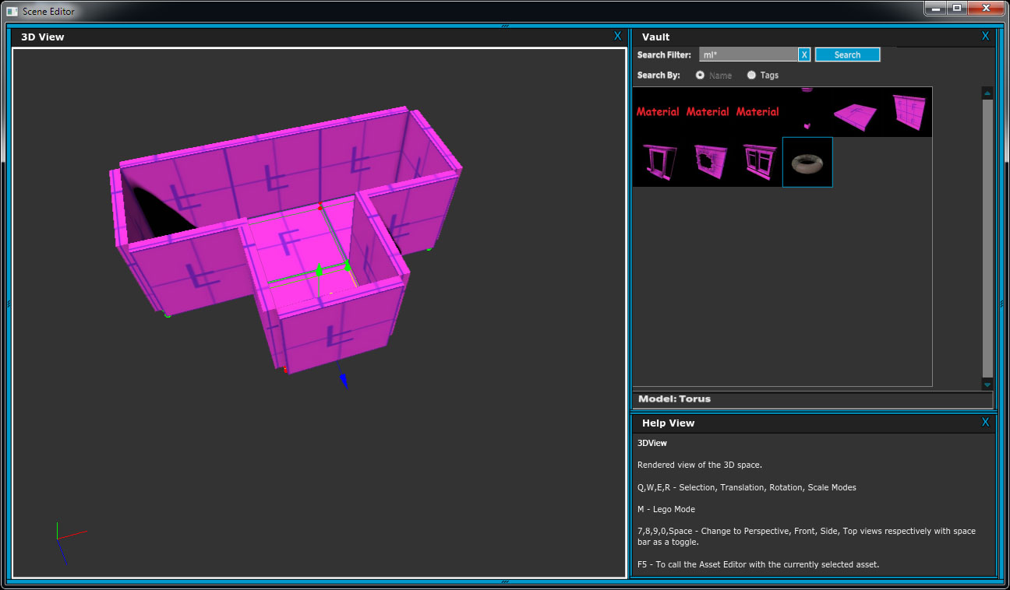
Example 4: Stamp mode

Slide 151
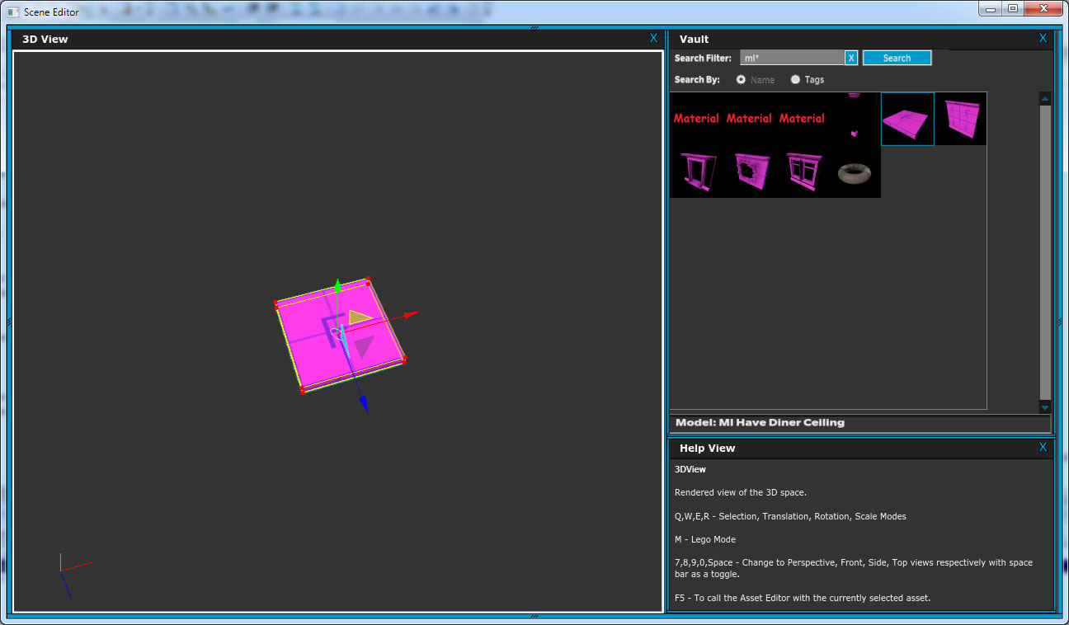
E.g. 3D manipulators have very little context.
(“Move/rotate/scale some object”)

Slide 152
Redefine context:
“building things made up of connected, modular parts”

Slide 153
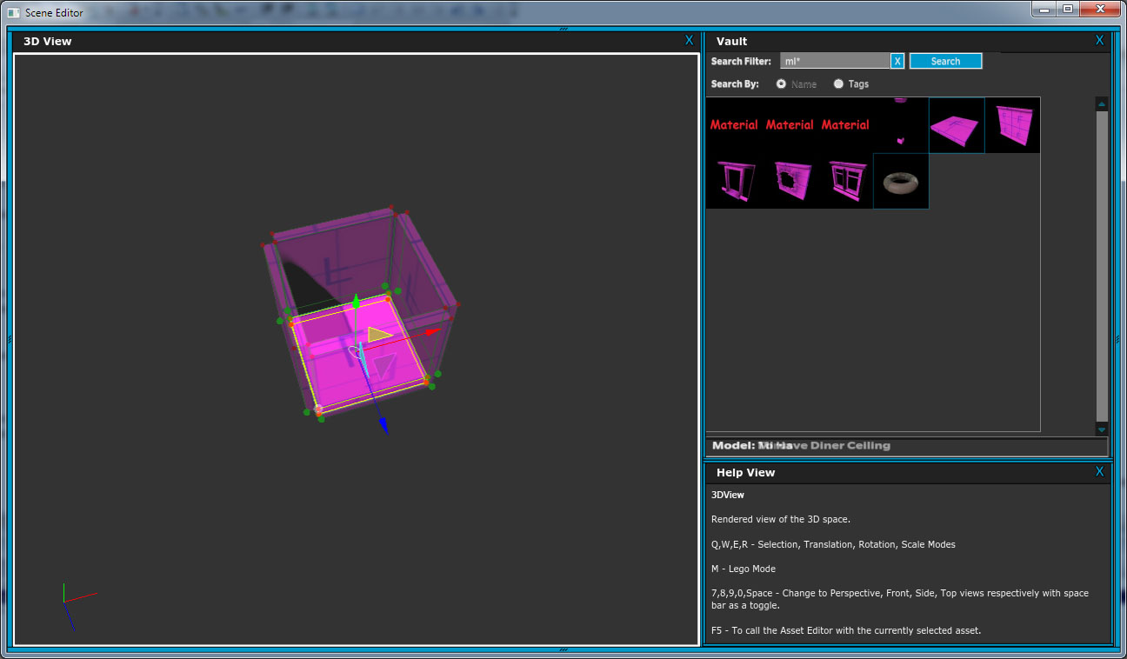
Hotkey: Modular stamp mode

Slide 154
Hotkey: Modular stamp mode
See ghosted set of connectable pieces

Slide 155
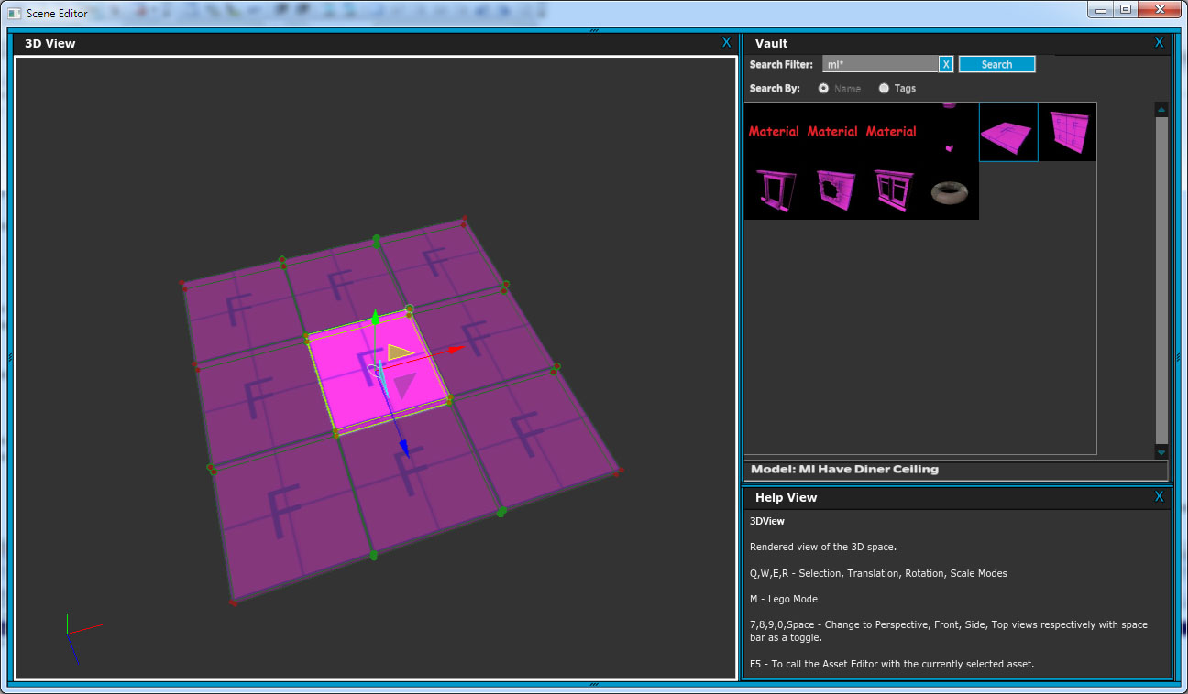
Tab another set of connectable pieces

Slide 156
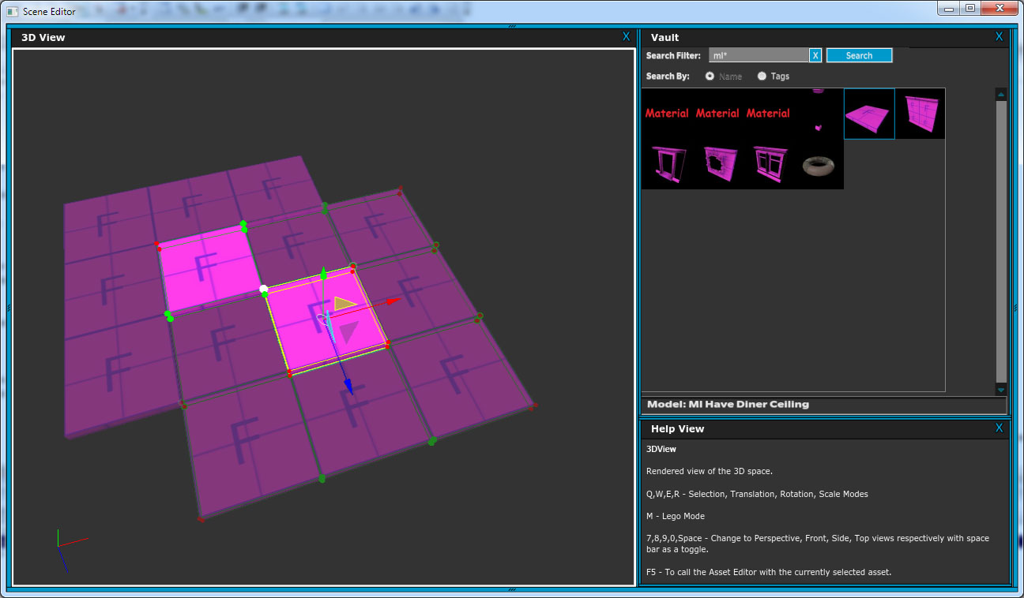
Click on ghosted piece to “stamp”

Slide 157
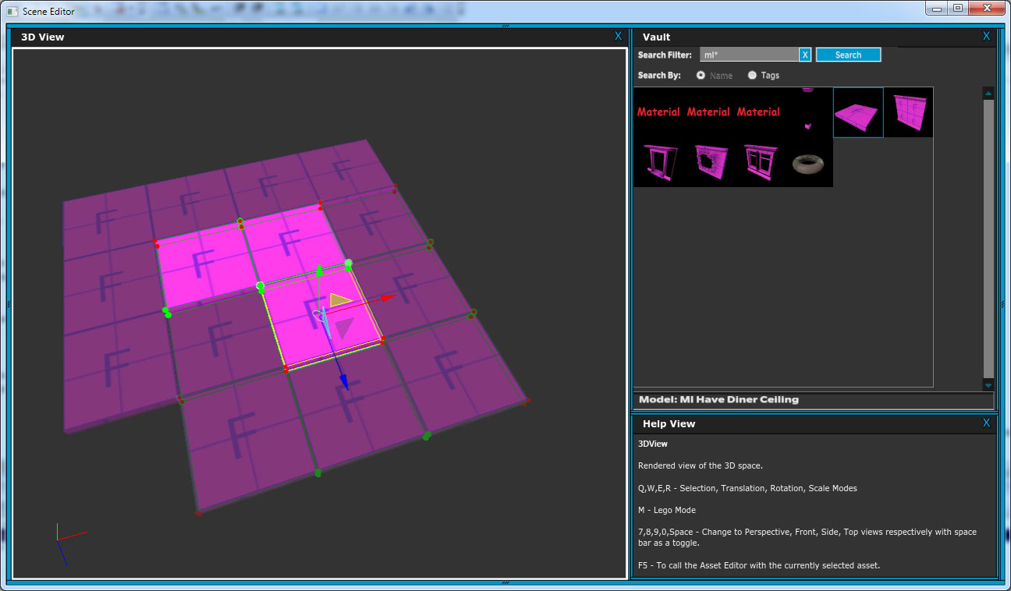

Slide 158
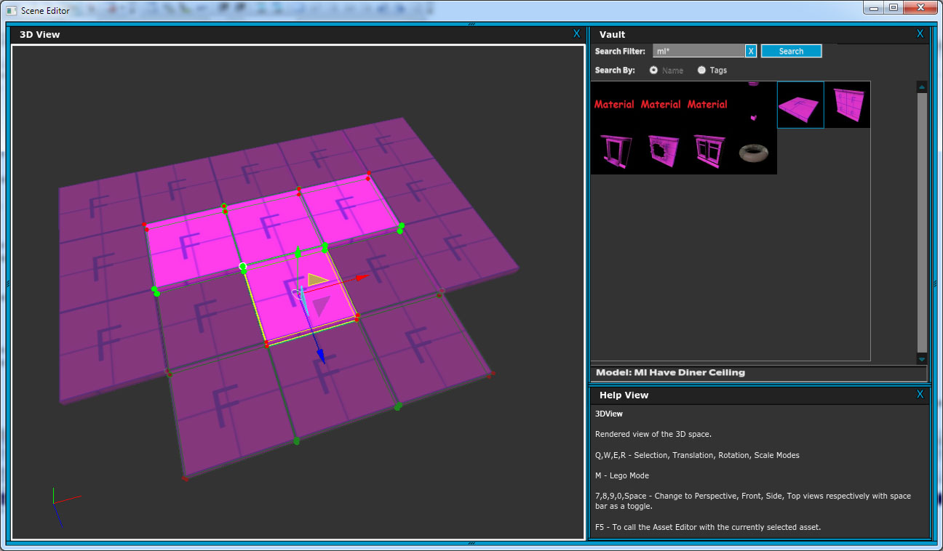

Slide 159
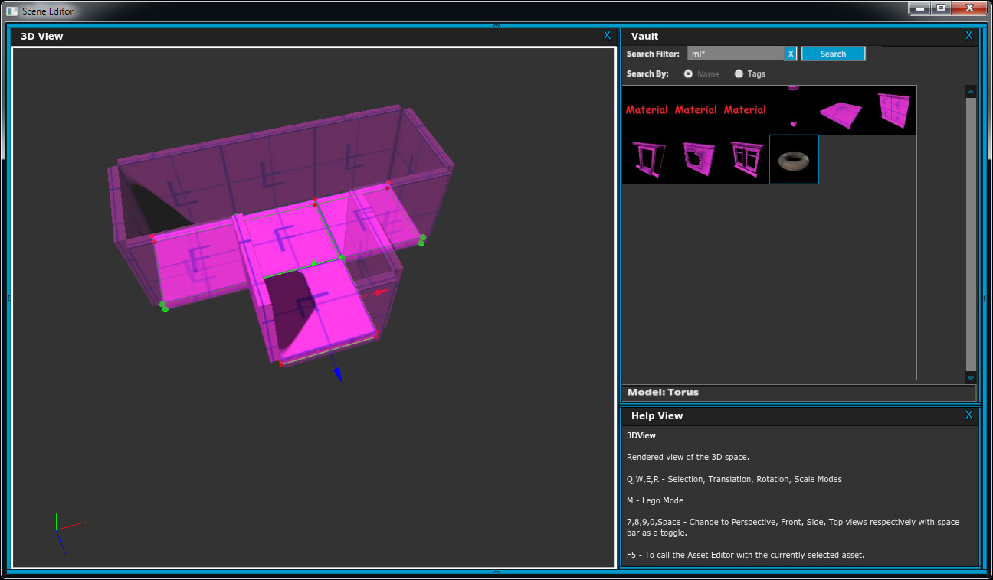
Tab back to other set

Slide 160
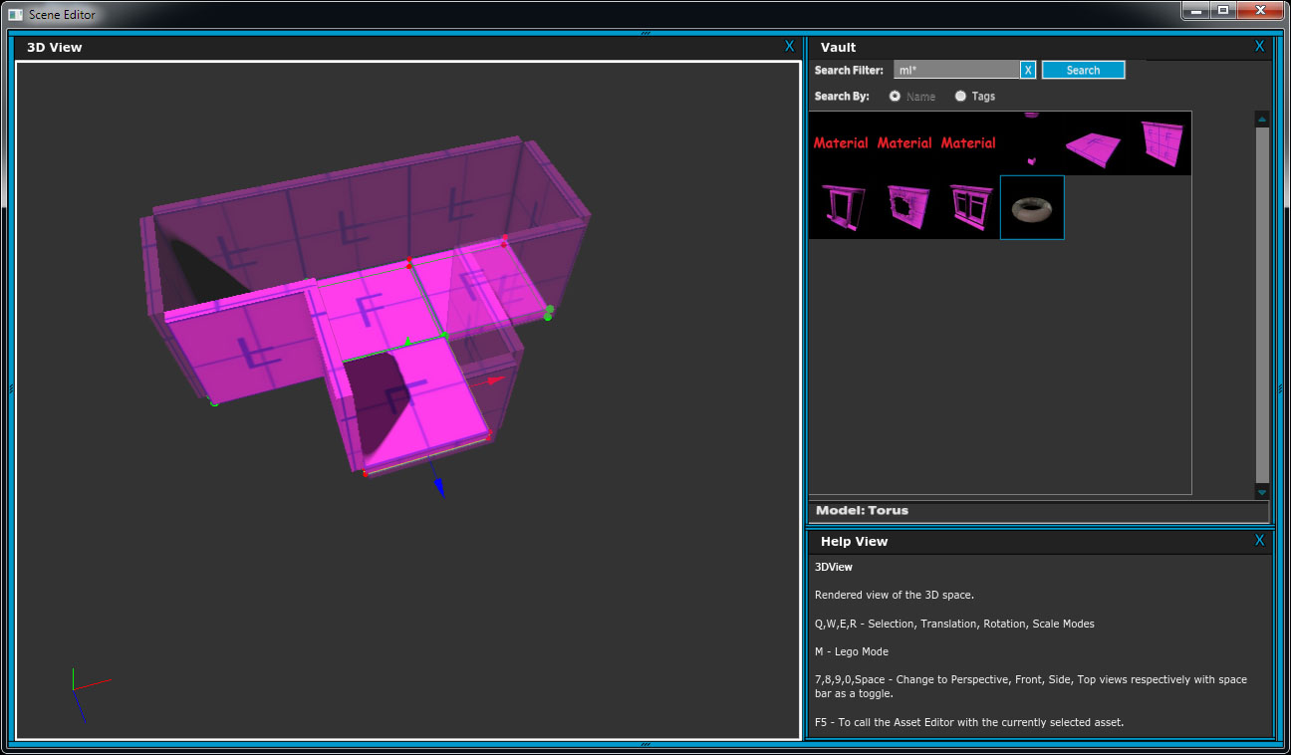

Slide 161
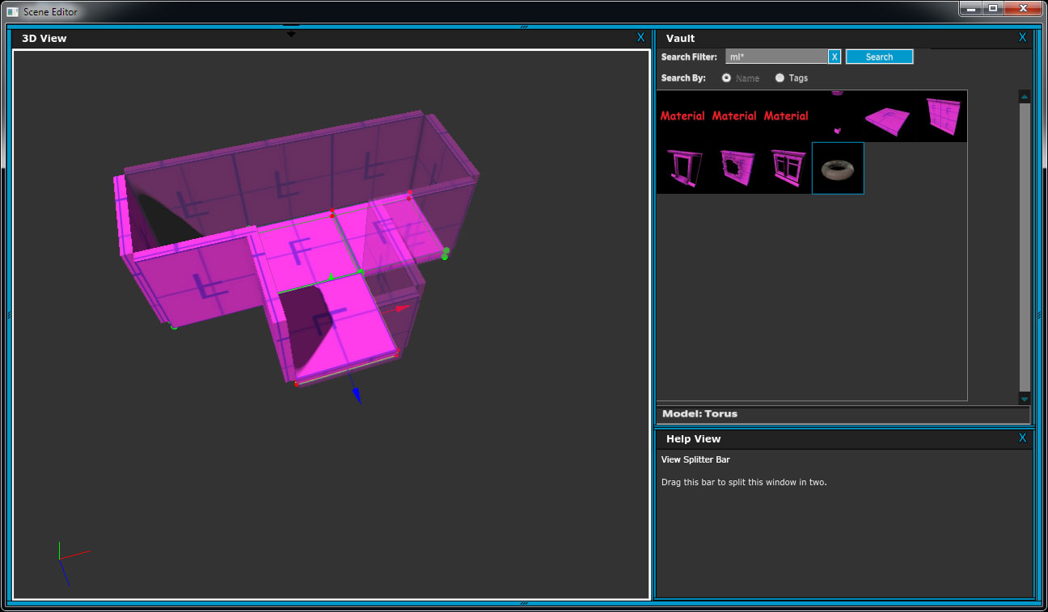

Slide 162
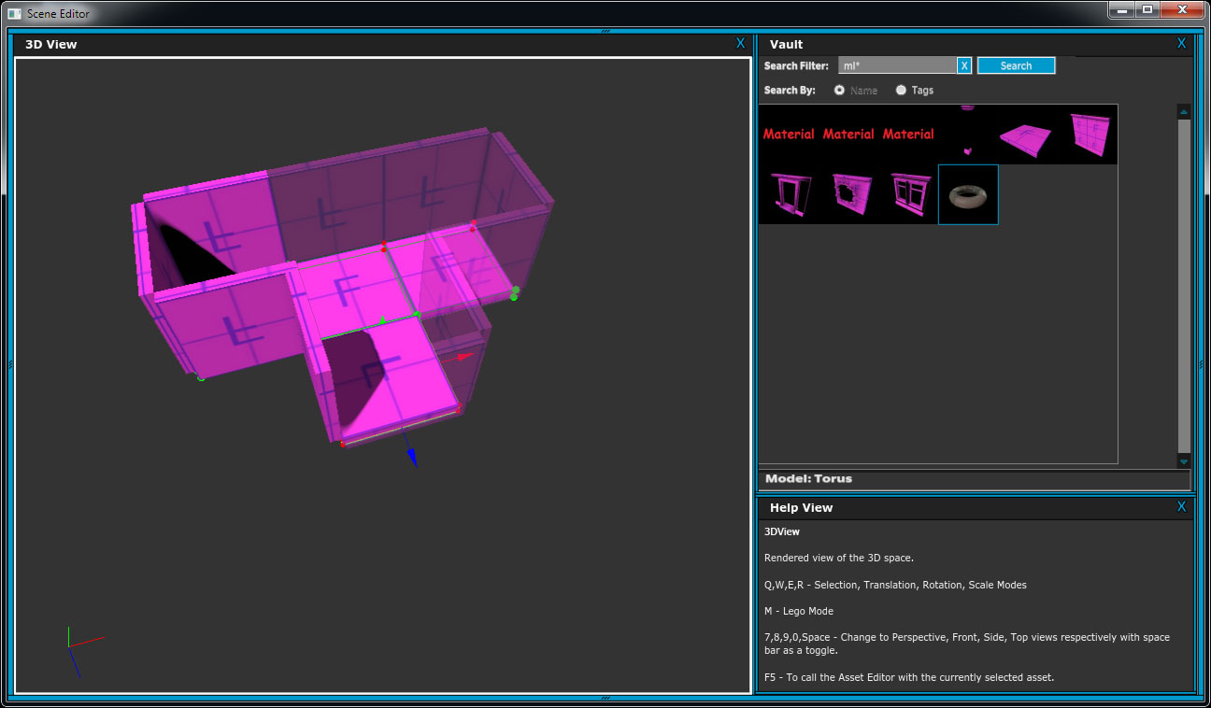

Slide 163
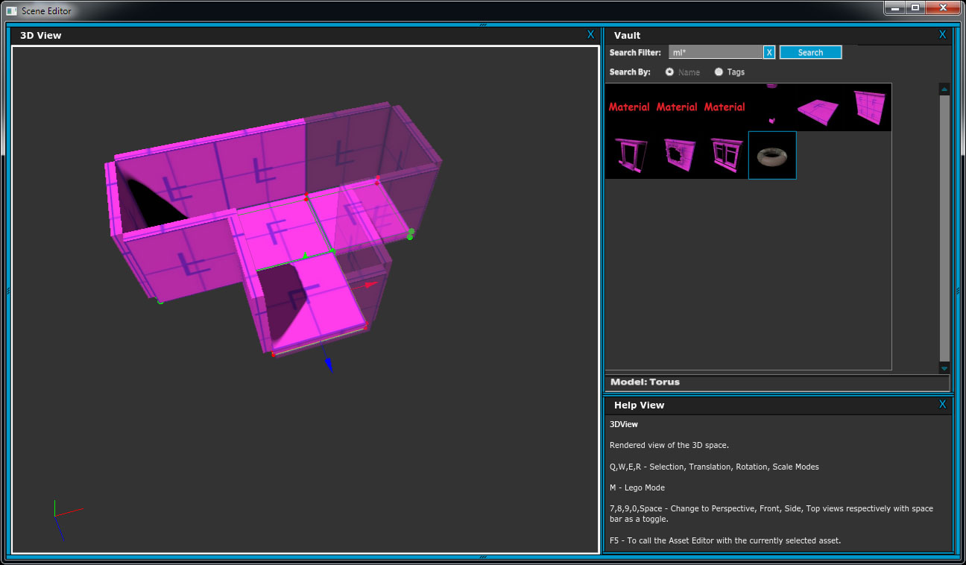

Slide 164
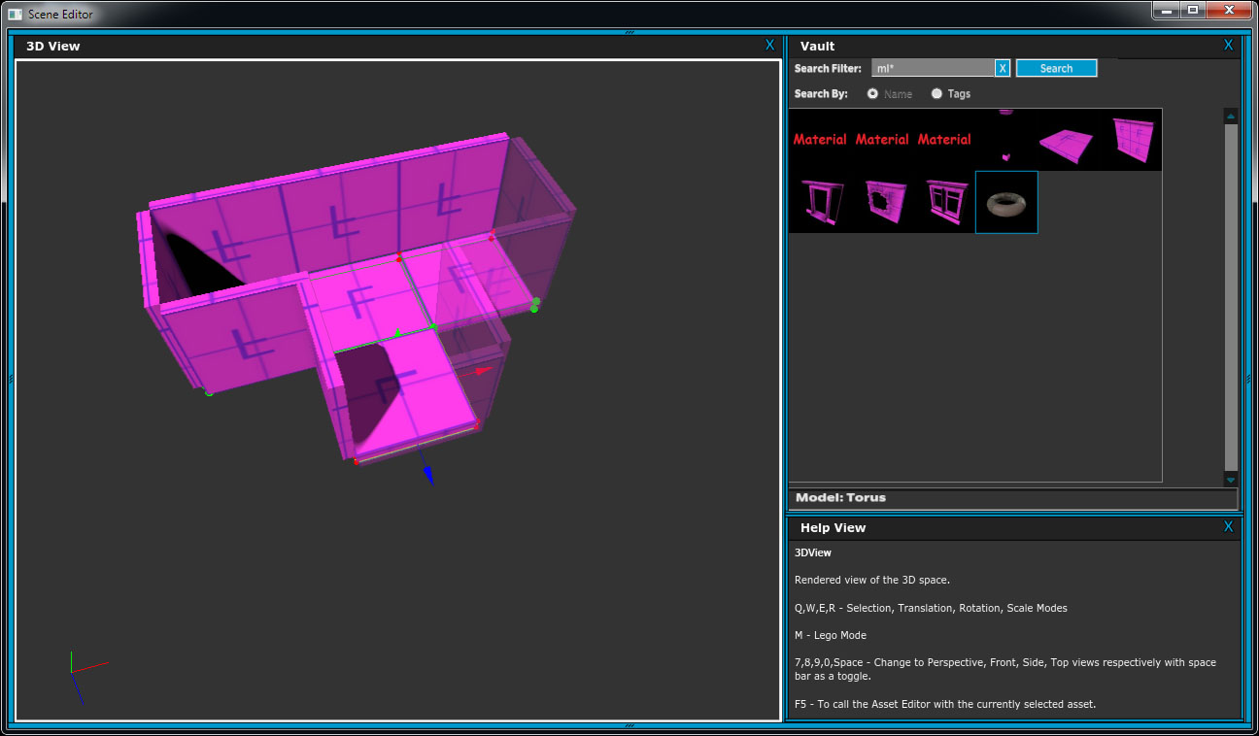

Slide 165
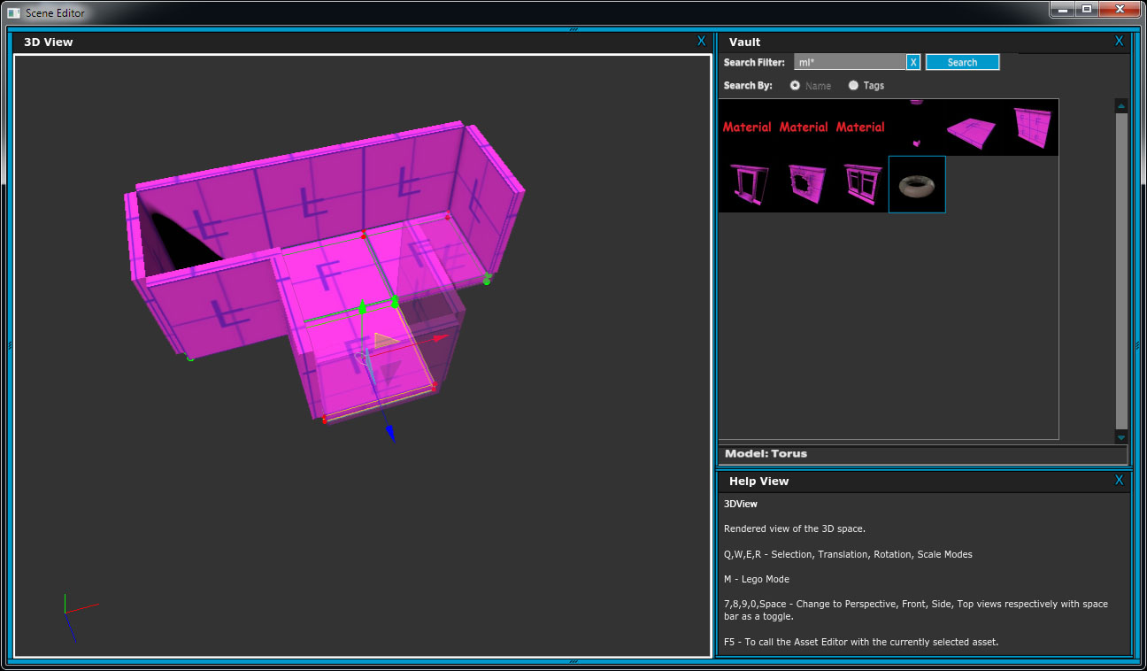

Slide 166


Slide 167
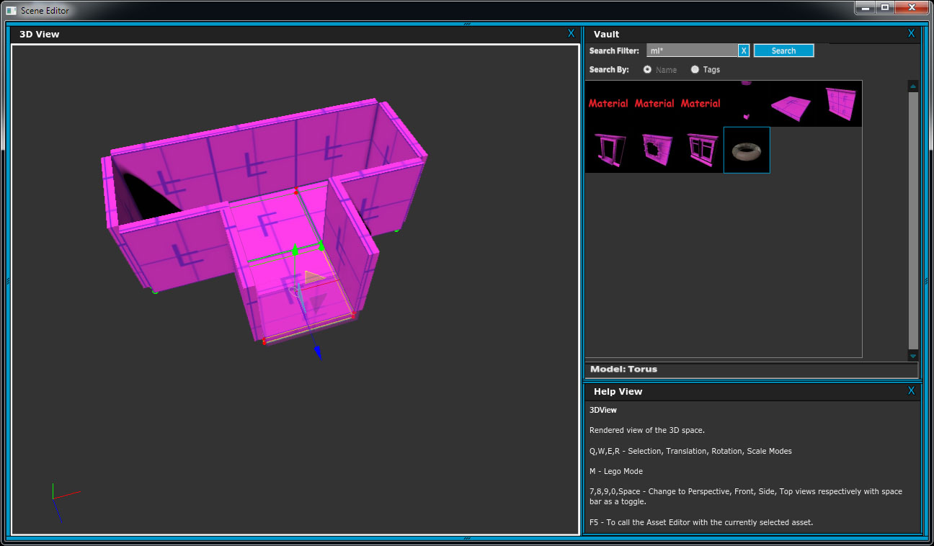

Slide 169
Example 4: Stamp mode
What happened?

Slide 170
Example 4: Stamp mode
What happened?
More specific context

Slide 171
Example 4: Stamp mode
What happened?
More specific context
Better information density

Slide 172
Example 4: Stamp mode
What happened?
More specific context
Better information density
Fast and simple message creation

Slide 173
Example 4: Stamp mode
What happened?
More specific context
Better information density
Fast and simple message creation
Immediate message translation and response

Slide 174
Example 4: Stamp mode
What happened?
More specific context
Better information density
Fast and simple message creation
Immediate message translation and response
Forgot: Muscle memory

Slide 175
Example 4: Stamp mode
What happened?
More specific context
Better information density
Fast and simple message creation
Immediate message translation and response
Forgot: Muscle memory
When in doubt, be like Maya

Slide 176
Example 4: Stamp mode
What happened?
More specific context
Better information density
Fast and simple message creation
Immediate message translation and response
Forgot: Muscle memory
When in doubt, be like Maya
The more different something is, the bigger the bridge to the old way needs to be.

Slide 177
Review

Slide 178
Review
The only way is to watch it live

Slide 179
Review
The only way is to watch it live
Choice is bad

Slide 180
Review
The only way is to watch it live
Choice is bad
Choice is good

Slide 181
Review
The only way is to watch it live
Choice is bad
Choice is good
20 Questions is all you ever need

Slide 182
Review
The only way is to watch it live
Choice is bad
Choice is good
20 Questions is all you ever need
Learning curve is bad

Slide 183
Review
The only way is to watch it live
Choice is bad
Choice is good
20 Questions is all you ever need
Learning curve is bad
Learning curve is good

Slide 184
Review
The only way is to watch it live
Choice is bad
Choice is good
20 Questions is all you ever need
Learning curve is bad
Learning curve is good
One minute is worth 12 iterations

Slide 185
Review
The only way is to watch it live
Choice is bad
Choice is good
20 Questions is all you ever need
Learning curve is bad
Learning curve is good
One minute is worth 12 iterations
When in doubt, be like Maya

Slide 186
Review
The only way is to watch it live
Choice is bad
Choice is good
20 Questions is all you ever need
Learning curve is bad
Learning curve is good
One minute is worth 12 iterations
When in doubt, be like Maya
Usability is triage

Slide 187
Review
The only way is to watch it live
Choice is bad
Choice is good
20 Questions is all you ever need
Learning curve is bad
Learning curve is good
One minute is worth 12 iterations
When in doubt, be like Maya
Usability is triage
To make things more usable, don’t try to maximize usability in everything

Slide 188
#README
“A mathematical theory of communication” -- Claude Shannon
“The Design of Everyday Things” -- Donald A. Norman
“The Man Who Lied to His Laptop: What We Can Learn About Ourselves from Our Machines” -- Clifford Nass and Corina Yen

Slide 189
Usability is not random #gdc13
macton@insomniacgames.com
@mike_acton

